Slide 1
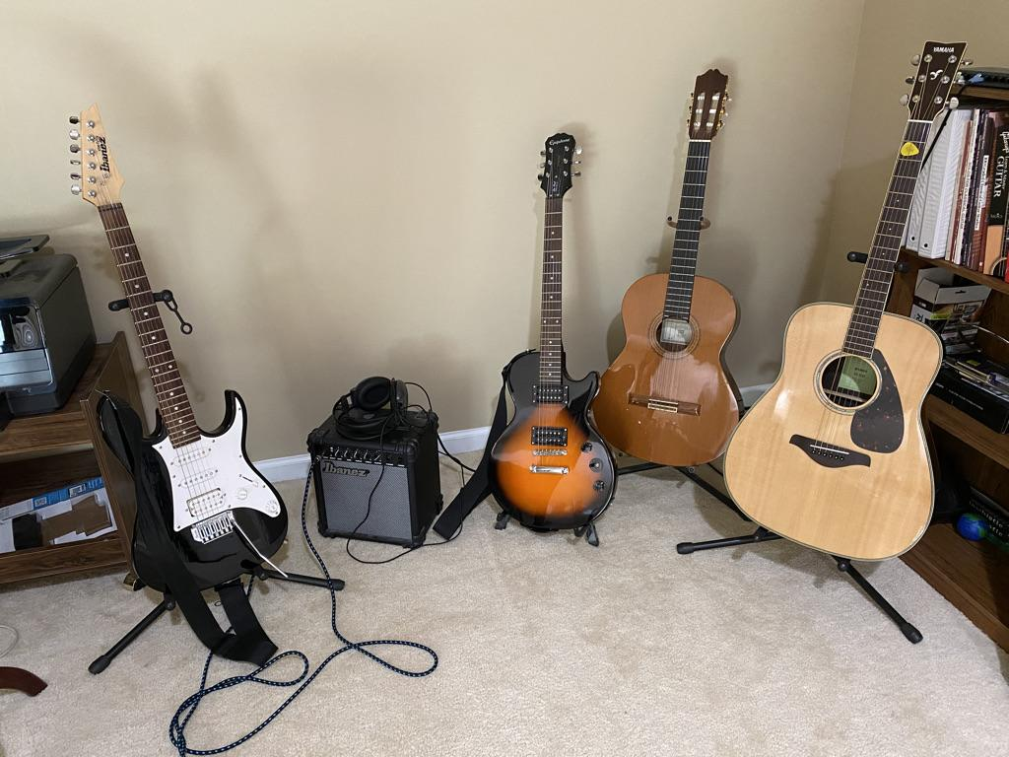
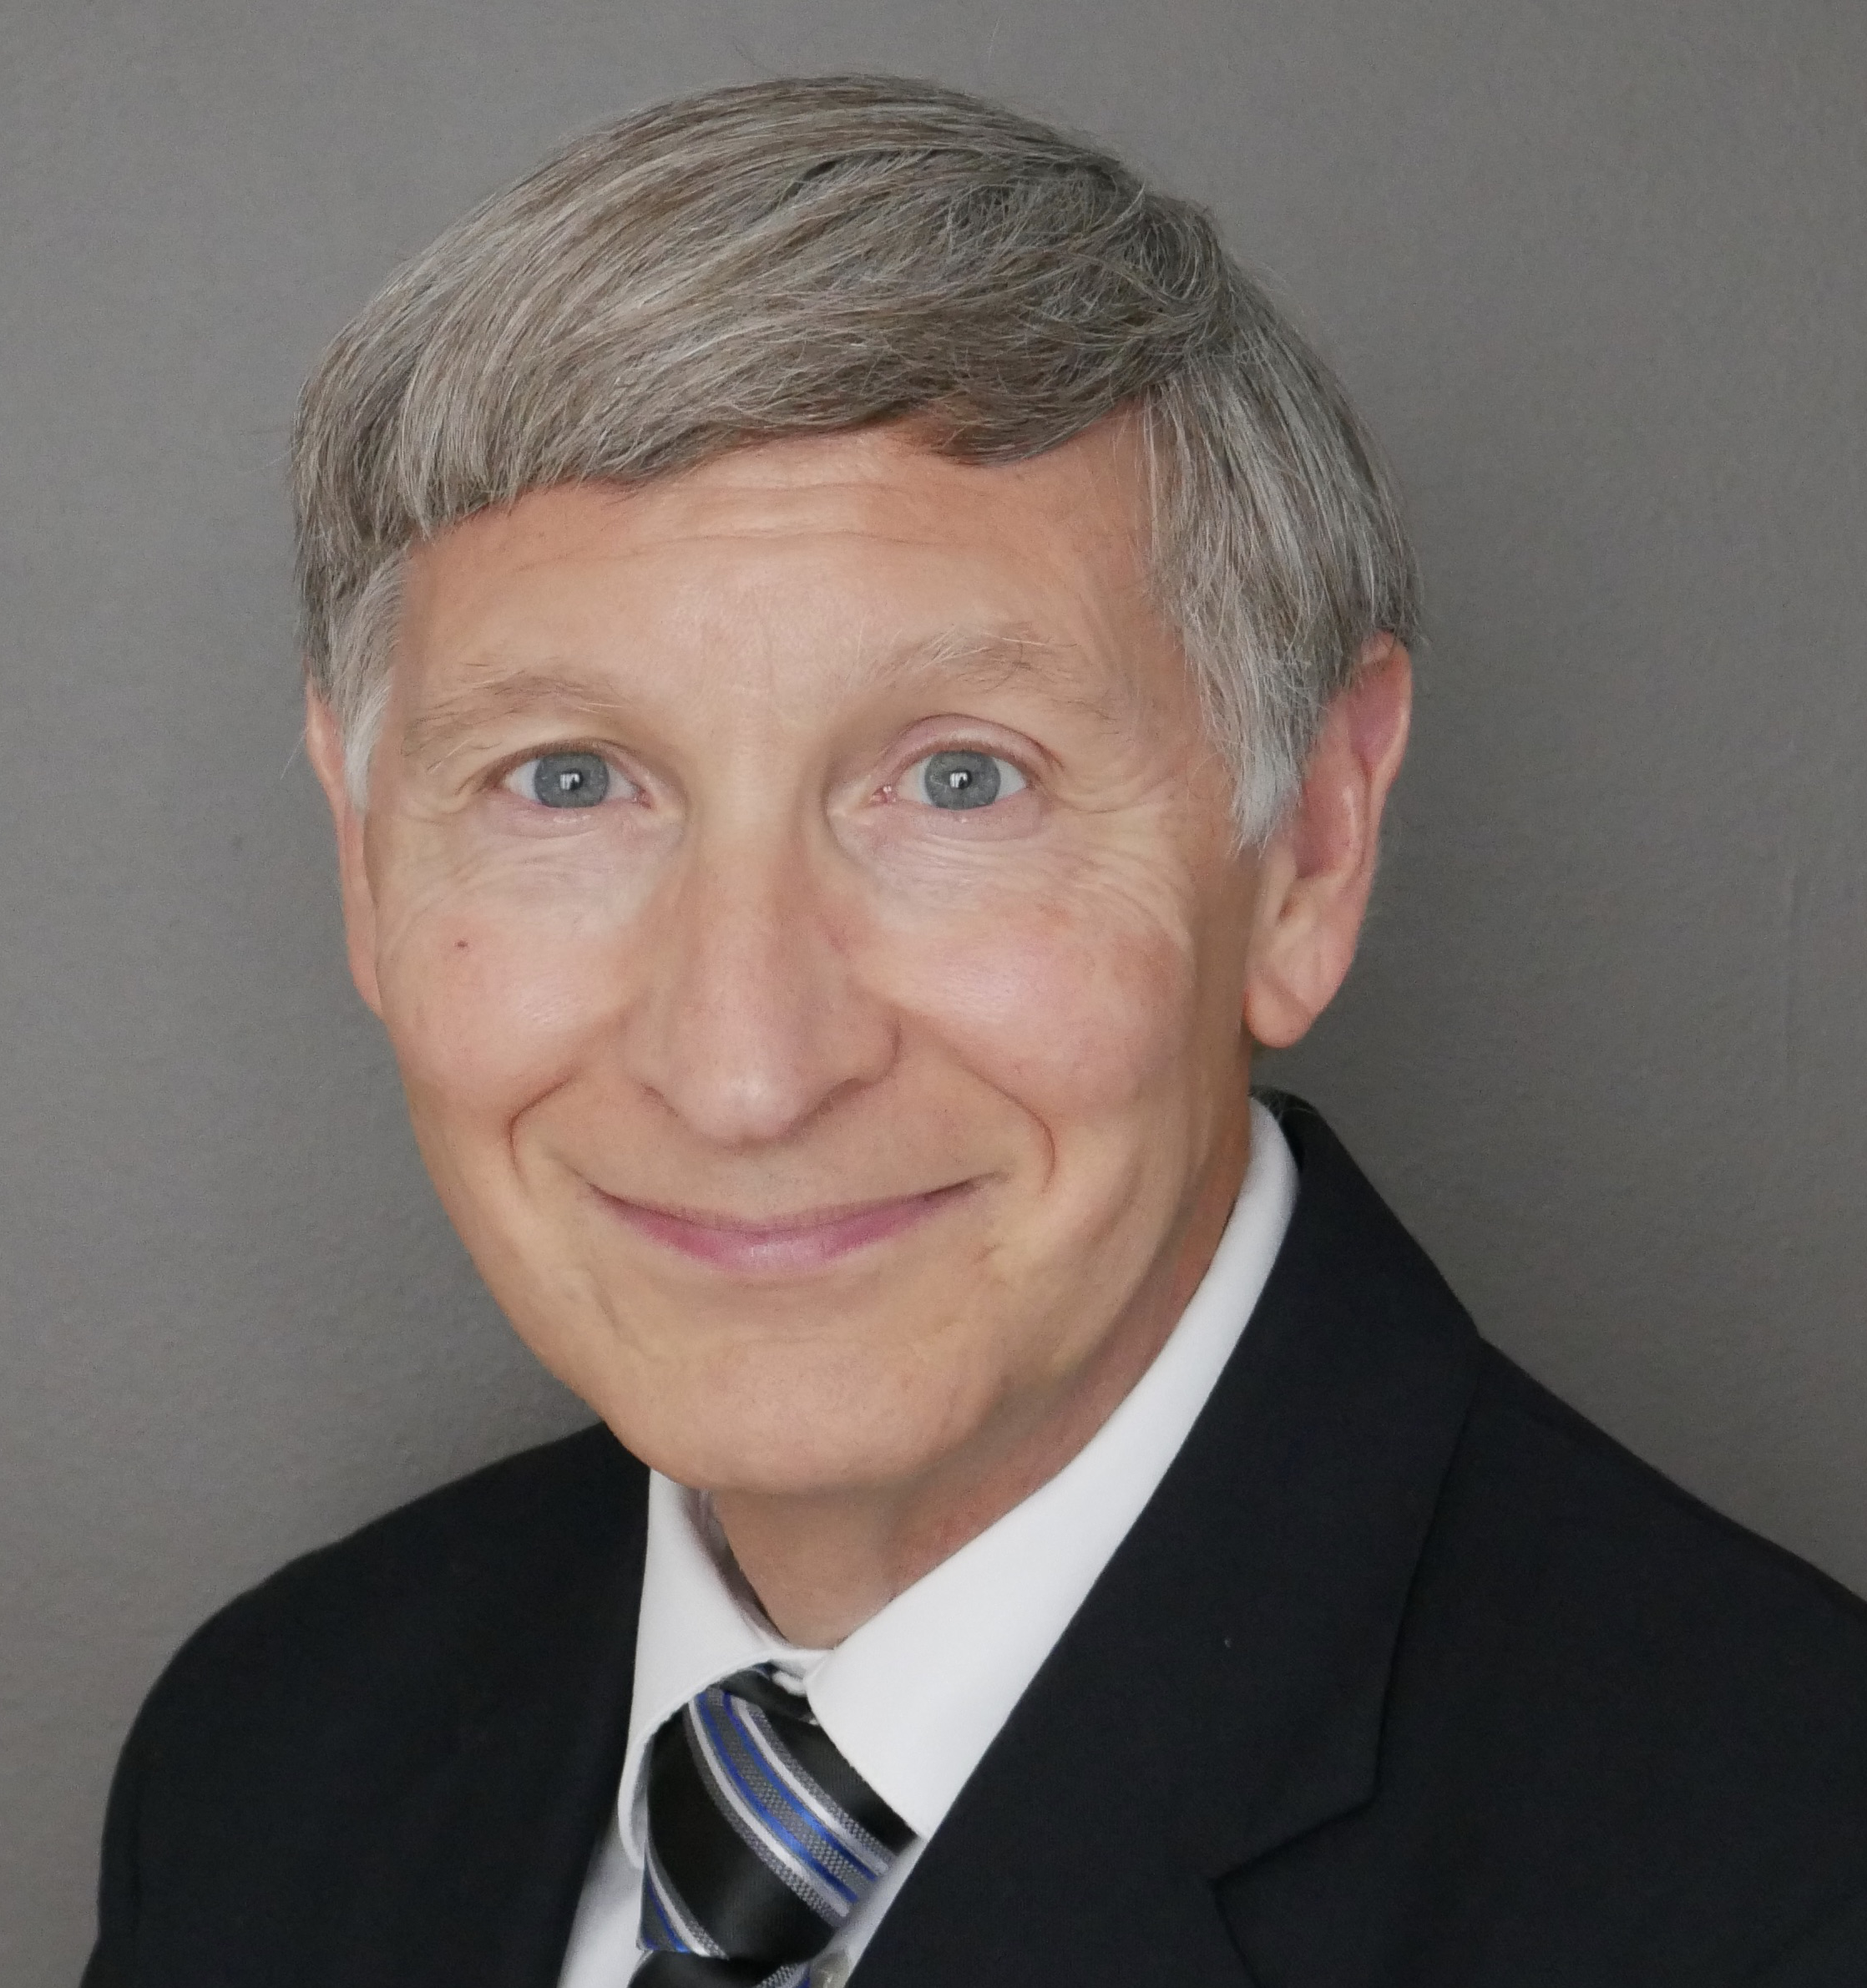
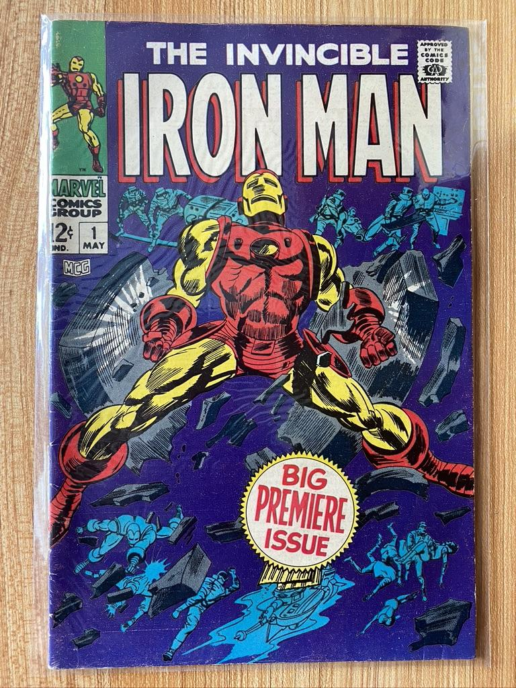
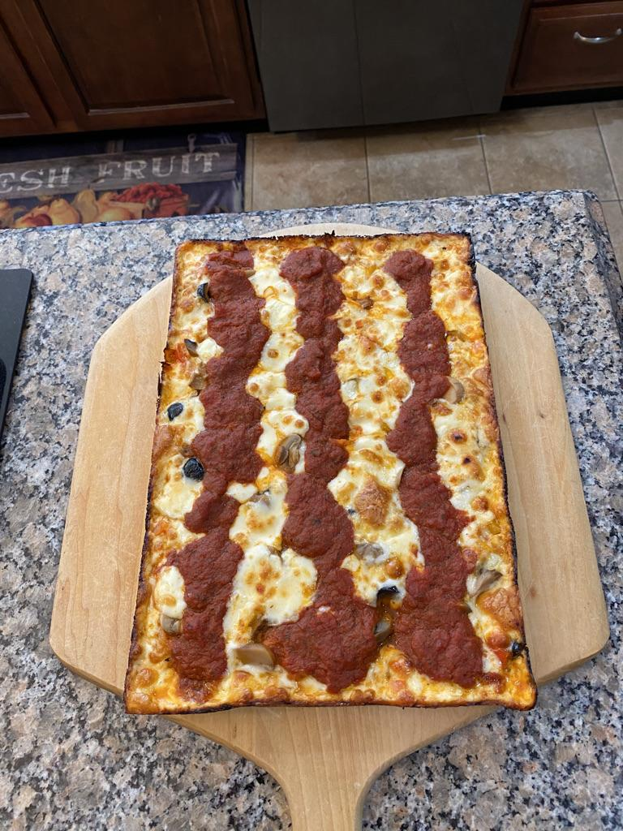
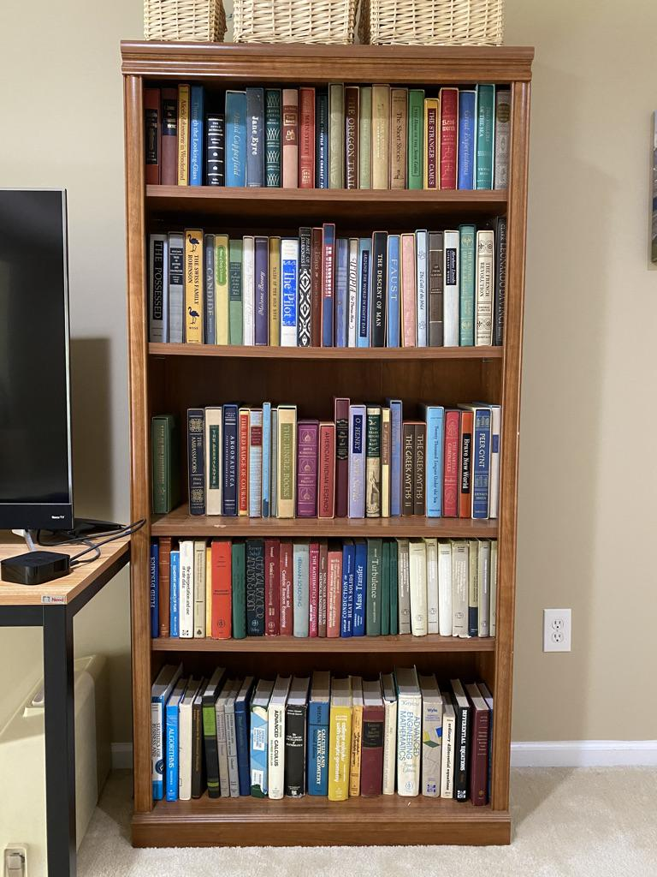
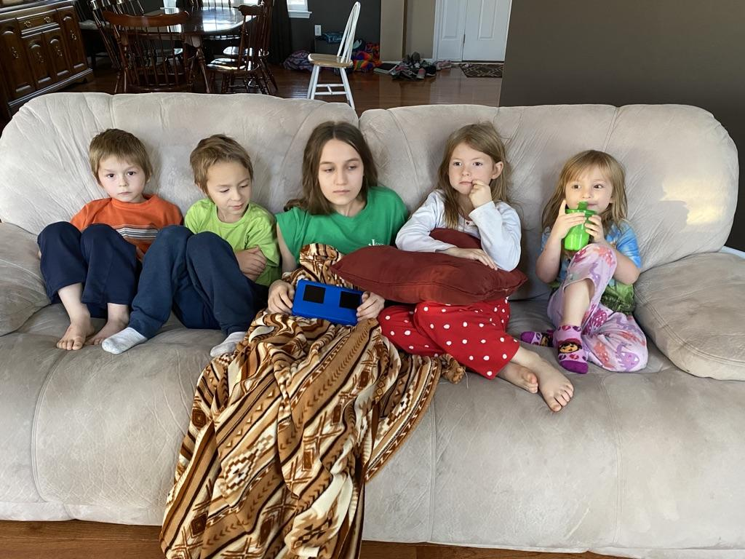
Professor George Witmer
Professor of Practice
Taught Capstone since joining Lehigh in 2017
Also Engineering 10 and CSE 252
BS Chem Eng (BYU), PhD Chemical Engineering (U Houston), MBA (Lehigh)
Shell (4m), Air Products (28y), PPL (2y), Lutron (8m)
Learning chemical engineering was fun but I like IT better
Wife (Julia) is retired chemistry / physics teacher
Daughter Melissa chemistry professor at PCC / Husband does IT/QC at JPL (NASA)
Daughter Cindy stay-at-home mom / Husband is a drama teacher (Lynn, Boston)
Son Mark is software engineer at Amazon / Wife is a goat farmer
Daughter Rebecca is getting a PhD in ME at Michigan / Husband does IT at Ford
9 grandchildren … so far

